Slide 1
Quality Assurance and Implementation
16
Systems Analysis and Design, 8e
Kendall & Kendall

Slide 2
Every Systems Analyst Should Understand the Methodology and Philosophy of Six Sigma

Slide 3
The Top-Down Approach
Top-down design allows the systems analyst to ascertain overall organizational objectives and how they are best met in an overall system.
The system is divided into subsystems and their requirements.
Notes:
The top-down approach means looking at the large picture of the system and then exploding it into smaller parts or subsystems.

Slide 4
Modular Development
Breaking the programming into logical, manageable portions or modules
Works well with top-down design
Each individual module should be functionally cohesive, accomplishing only one function.
Notes:
This kind of programming works well with top-down design because it emphasizes the interfaces between modules and does not neglect them until later in systems development.

Slide 5
System Documentation
Procedure manuals
The FOLKLORE method
Notes:
There is no single standard design and documentation technique in use today. Each technique has its own advantages and disadvantages, because each one has unique properties.

Slide 6
Procedure Manuals
The English-language component of documentation
Key sections:
Introduction
How to use the software
What to do if things go wrong
A technical reference section
An index
Information on how to contact the manufacturer
Notes:
Procedure Manuals – may also contain program codes, flowcharts, and so on.
intended to communicate to those who use them.

Slide 7
Procedure Manuals (Continued)
Procedure manual complaints:
They are poorly organized.
It is hard to find needed information.
The specific case in question does not appear in the manual.
The manual is not written in plain English.

Slide 8
Testing, Maintenance, and Auditing
The testing process
Maintenance practices
Auditing
Notes:
Once the analyst has designed and coded the system, testing, maintenance, and auditing of it are prime considerations.

Slide 9
The Testing Process
Program testing with test data
Link testing with test data
Full system testing with test data
Full system testing with live data
Notes:
All the system’s newly written or modified application programs --- as well as new procedural manuals, new hardware, and all system interfaces --- must be tested thoroughly.

Slide 10
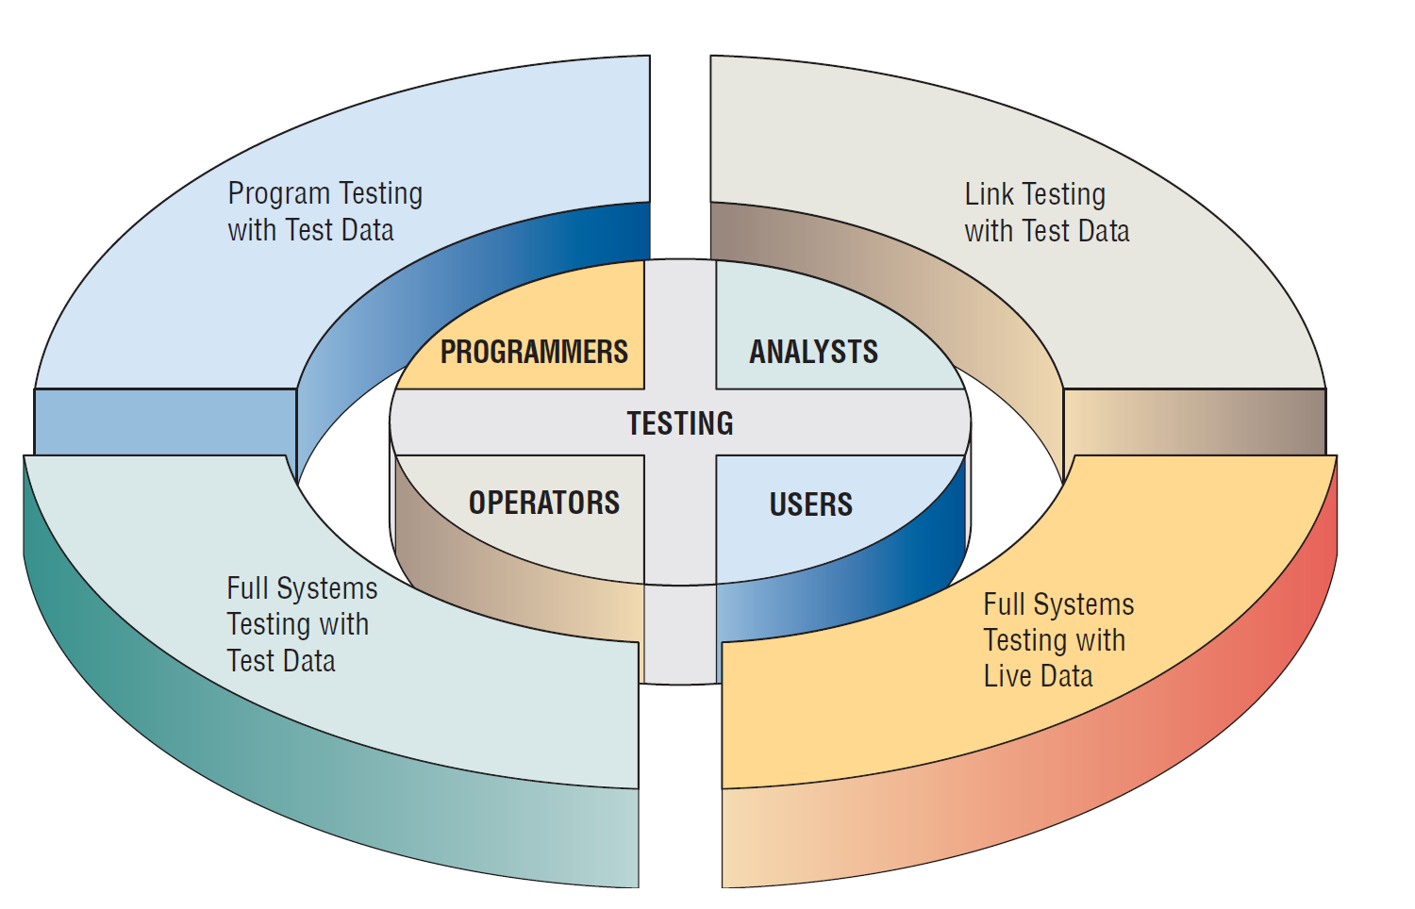
Programmers, Analysts, Operators, and Users All Play Different Roles in Testing Software and Systems
Notes:
Programmers, analysts, operators, and users all play different roles in the various aspects of testing.

Slide 11
Program Testing with Test Data
Desk check programs
Test with both valid and invalid data.
Check output for errors and make any needed corrections.
Notes:
Desk check programs – the programmer follows each step in the program on paper to check whether the routine works as it is written.
Test with both valid and invalid data – these data are run to see if base routines work and also to catch errors.
Check output for errors and make any needed corrections – the analyst might point out to the programmer omissions of data types to be added in later tests.

Slide 12
Link Testing with Test Data
Also referred to as string testing
Checks to see if programs that are interdependent actually work together as planned
Test for normal transactions.
Test with invalid data.
Notes:
Test for normal transactions – those that make up the bulk of the load.
Test with invalid data – if the system works with normal transactions, variations are added, including invalid data used to ensure that the system can properly detect errors.

Slide 13
Full System Testing with Test Data
Adequate documentation in procedure manuals
Are procedure manuals clear enough?
Do work flows actually “flow”?
Is output correct and do users understand this output?
Notes:
When link tests are concluded, the system as a complete entity must be tested.
Operators and end users become actively involved in testing.
Adequate documentation in procedure manuals – to afford correct and efficient operation.
Are procedure manuals clear enough – do they communicate how data should be prepared for input.
Do work flows actually “flow” – those work flows necessitated by the new or modified system.
Is output correct and do users understand this output – do users understand that this is how it will look in its final form.

Slide 14
Full System Testing with Live Data
Comparison of the new system’s output with what you know to be correctly processed output
Only small amounts of live data are used
Notes:
Live data – data that have been successfully processed through the existing system.

Slide 15
Maintenance Practices
Reduce maintenance costs.
Improve the existing software.
Update software in response to the changing organization.
Ensure channels for feedback.
Notes:
The better the system design, the easier it will be to maintain and the less money the business will have to spend on maintenance.
Reduce maintenance costs – software maintenance can devour upwards of 50 percent of the total data processing budget for a business. Approximately 70 percent of software errors have been attributable to inappropriate software design.
Improve the existing software – rather than to respond to a crisis or failure.
Update software in response to the changing organization – emergency and adaptive maintenance comprises less than half of all system maintenance.
Ensure channels for feedback – users must be able to communicate problems and suggestions easily to those who will be maintaining the system.
Classification scheme – designates the perceived importance of the maintenance being suggested.

Slide 16
Auditing
Having an expert who is not involved in setting up or using the system examine information in order to ascertain its reliability
There are internal and external auditors.
Internal auditors study the controls used in the information system to make sure that they are adequate.
External auditors are used when the information system processes data that influences a company’s financial statements.
Notes:
Internal auditors work for the same organization that owns the information system.
External auditors are hired from the outside.

Slide 17
Client-Server Technology
The client-server model refers to a design model that can be thought of as applications running on a network.
The client is a networked computer that uses small programs to do front-end processing, including communicating with the user.
Notes:
If a file server crashes all clients using the applications on the server are affected.
A print server on a LAN is accessible to all workstations.
Web Servers are software, not a combination of software and hardware as print servers and file servers are.

Slide 18
Client-Server Model Advantages, Disadvantages
Advantage—greater computer power and greater opportunity to customize applications
Disadvantage—more expensive and applications must be written as two separate software components each running on separate machines
Notes:
Although lower processing costs are cited as a benefit of the C?S model, there is very little actual data available to prove it.
There are well-documented high start-up or switch-over costs associated with a movement to a C/S architecture.

Slide 19
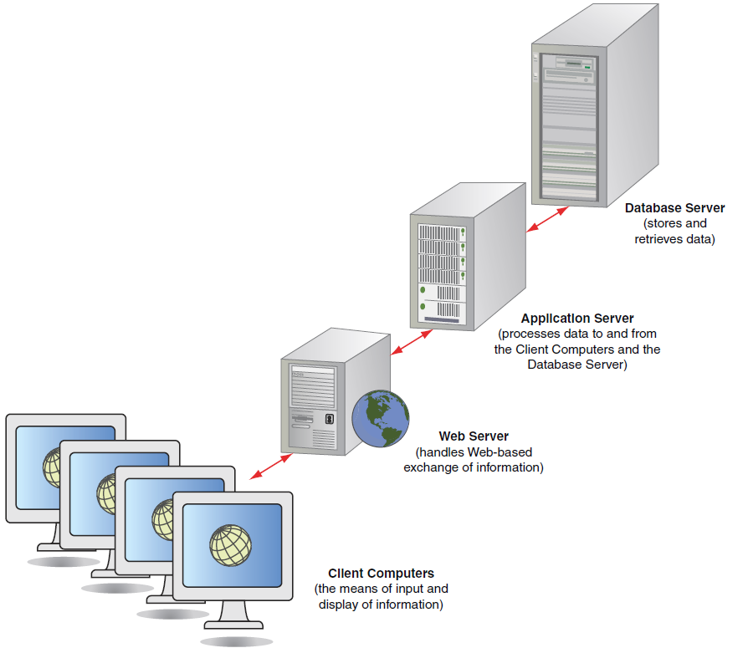
A Client/Server System Configuration

Slide 20
Cloud Computing
Organizations and individual users can use:
Web services
Database services
Application services over the Internet
Done without having to invest in corporate or personal hardware, software, or software tools

Slide 21
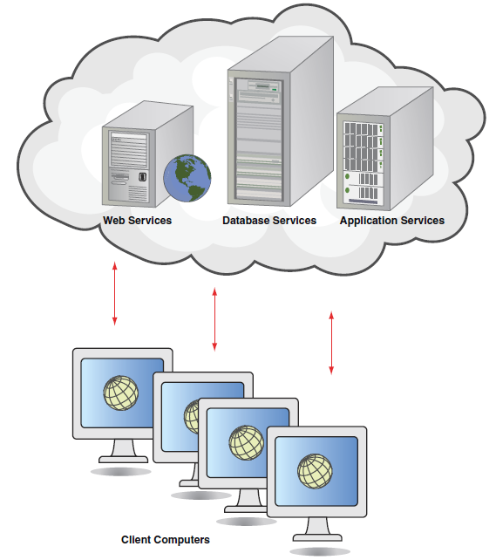
Cloud Computing

Slide 22
Training
Who to train
People who train users
Training objectives
Training methods
Training sites
Training materials
Notes:
Training strategies are determined by who is being trained and who will train them.

Slide 23
Who to Train
All people who will have primary or secondary use of the system
Ensure that users of different skill levels and job interests are separated.
Notes:
It is trouble to include novices in the same training sessions as experts – novices are quickly lost and experts are rapidly bored with basics

Slide 24
People Who Train Users
Vendors
Systems analysts
External paid trainers
In-house trainers
Other system users
Notes:
Vendors – often provide offsite one or two day training sessions on their equipment.
Systems analysts – know the organization so can often provide good training.
External paid trainers – may have broad experience in teaching people how to use a variety of computers.
In-house trainers – usually familiar with the skills and learning preferences of personnel and can tailor materials to their needs.
Other system users – let the trainer train a group of users who then act as trainers.

Slide 25
Conversion Strategies
Direct changeover
Parallel conversion
Gradual or phased conversion
Modular prototype conversion
Distributed conversion
Notes:
There is no single best way to proceed with conversion.

Slide 26
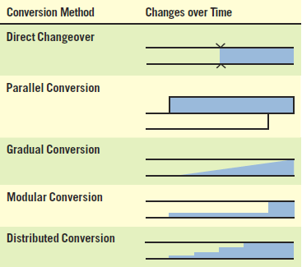
Five Conversion Strategies for Information Systems (Figure 16.16)

Slide 27
Direct Changeover
Old system stops, new one starts
Needs extensive testing
Risky approach to conversion
Users may resent being forced into using an unfamiliar system without recourse.
No adequate way to compare new results to old

Slide 28
Parallel Conversion
Run the old and new systems at the same time.
The advantage is that you can check new data against old data.
The disadvantage is doubling employees’ workloads.

Slide 29
Gradual Conversion
Combines best features of parallel and direct conversion
Volume of transactions is gradually increased
Advantage is that users get involved with the system gradually

Slide 30
Modular Prototype Conversion
Each module is tested and put into use.
The advantage is that each module is thoroughly tested before being used.
Users are familiar with each module as it becomes operational.
Object-oriented methodologies often use this approach.

Slide 31
Distributed Conversion
When there are many installations of the same system, such as at branch offices
Install software at one office
Advantage is that problems can be detected and contained
Disadvantage is that even when one conversion is successful, each site will have its own peculiarities to work through
Notes:
No particular conversion approach is equally suitable for every system implementation.

Slide 32
Security Concerns
Physical security
Logical security
Behavioral security
Notes:
As more people in the organization gain greater computer power, gain access to the Web, or connect to intranets and extranets, security becomes increasingly difficult and complex.

Slide 33
Security Concerns (Continued)
Physical security is securing the through physical means. computer facility, its equipment, and software
Logical security refers to logical controls in the software itself.
Behavioral security is building and enforcing procedures to prevent the misusing of computer hardware and software.
Notes:
Physical security – machine-readable badges, human sign-in/sign-out system, closed circuit television cameras to monitor computer areas, backing up data frequently and storing backups in a fireproof, waterproof area.
Logical security – passwords, firewall.
Behavioral security – employees should clearly understand what is expected of them, what is prohibited, and the extend of their rights and responsibilities.

Slide 34
Disaster Recovery Planning
Identify teams responsible for managing a crisis.
Eliminate single points of failure.
Determine data replication technologies that match the organization’s timetable.
Create detailed relocation and transportation plans.
Notes:
Disasters might be natural or man-made:
power outage
hurricane or earthquake
9/11
Disaster preparedness suggests what a company should do if it encounters a crisis.
Disaster recover looks at how a business can continue in the aftermath of a disaster and how it can restore essential systems within the IT infrastructure.

Slide 35
Disaster Recovery Planning (Continued)
Provide recovery solutions that include an off-site location.
Ensure the physical and psychological well-being of employees and others.

